Slide 1
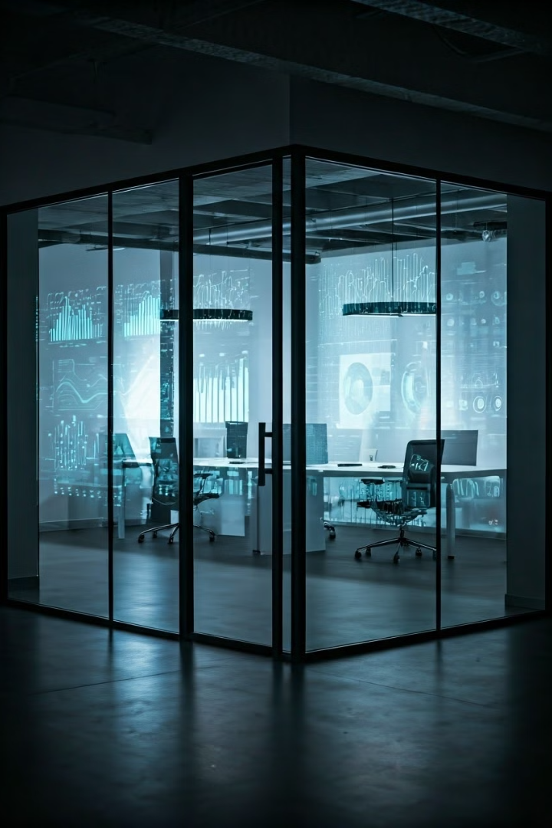
Welcome to Our Data Analysis Journey
ALX_DAT1_G4d
Group (D)
G

Slide 2

Mental Health & Technology Usage Analysis
This presentation outlines the analysis of a dataset focusing on mental health statistics and technology usage. The data includes attributes such as age, gender, and mental health status. The analysis utilizes libraries like Pandas, NumPy, Matplotlib, and Seaborn to uncover insights and trends.

Slide 3

INTROCUTION
let's have a general IDEA about we are going to talk about!

Slide 4

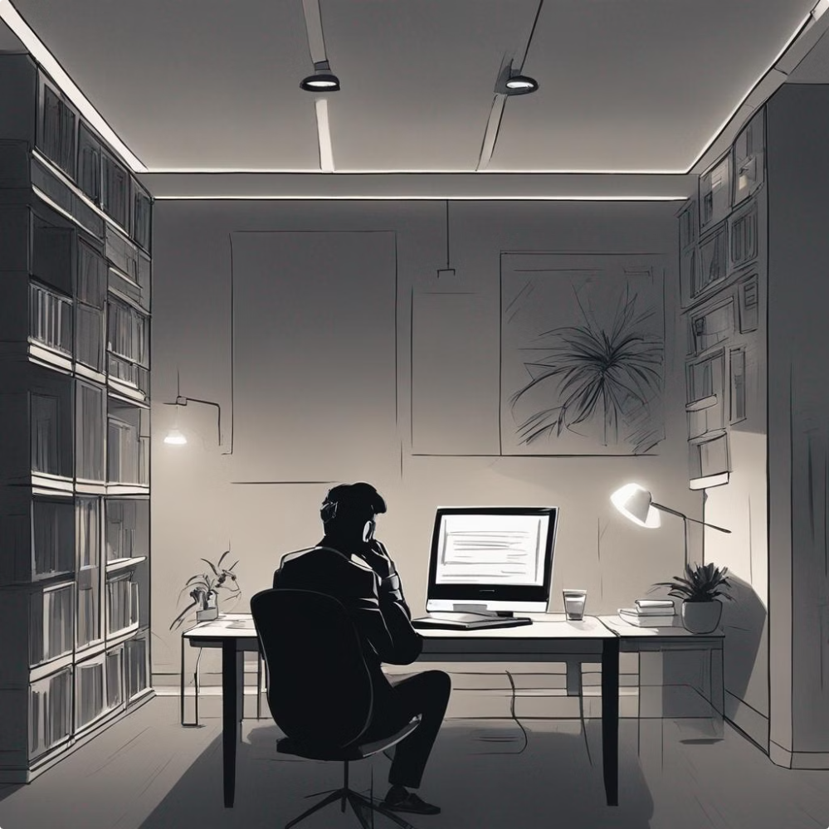
Technology's Impact on Mental Health
The digital age has brought remarkable advancements, but its impact on mental health is a growing concern. The increasing reliance on technology, particularly smartphones and social media, presents both opportunities and challenges. We'll delve into the complexities of technology's influence on our well-being.

Slide 5

The Rise of Digital Technology
1
Early Computers
The first electronic computers, like ENIAC, emerged in the mid-20th century, marking the dawn of a new era of computation.
2
Personal Computers
The invention of the personal computer in the 1970s brought computing power into homes, revolutionizing individual access to information and creativity.
3
Internet and Mobile Devices
The internet's rise in the 1990s and the subsequent development of smartphones in the 2000s created a truly interconnected world, connecting billions of people and enabling instant communication and access to information.

Slide 6

Positive Impacts of Technology
Enhanced Communication
Access to Information
Technology has dramatically improved communication, connecting people across continents and facilitating instant messaging, video calls, and social media interactions.
The internet provides access to a vast repository of knowledge, making information readily available on various topics, including education, research, and news.
Convenience and Efficiency
Entertainment and Creativity
Technology streamlines tasks, from online shopping and banking to automated services and productivity tools, saving time and effort.
Technology offers a wide range of entertainment options, from streaming services and gaming to creative platforms for artistic expression and self-discovery.

Slide 7
Negative Impacts of Technology
Distraction and Reduced Productivity
Sleep Disruption
Social Isolation and Loneliness
Cyberbullying and Online Harassment
The blue light emitted from electronic devices can interfere with melatonin production, making it harder to fall asleep and impacting sleep quality.
Excessive screen time can lead to reduced face-to-face interactions, fostering feelings of isolation and loneliness, particularly for individuals who rely heavily on online communication.
The anonymity of the internet can embolden bullies and harassers, leading to emotional distress and negative impacts on self-esteem.
Constant notifications and the allure of social media can disrupt focus, leading to decreased productivity and difficulty concentrating on tasks.

Slide 8
Excessive Screen Time and Its Effects
Eye Strain
1
Prolonged screen exposure can lead to eye strain, headaches, and blurred vision.
Sleep Disruption
2
Blue light emitted from screens can interfere with melatonin production, making it harder to fall asleep and affecting sleep quality.
Neck and Back Pain
3
Poor posture while using devices can strain the neck and back muscles, leading to discomfort and pain.
Mental Health Impact
4
Excessive screen time can contribute to anxiety, depression, and feelings of isolation, particularly when it displaces real-world interactions.

Slide 9




Social Media and Mental Health
Social Comparison
Stress and Anxiety
Addiction
Social media often presents curated versions of reality, leading to feelings of inadequacy and envy.
Notifications, messages, and the need to stay connected can create a sense of constant pressure and stress.
Social media can be addictive, leading to excessive scrolling and neglecting real-life activities.
Constant comparison can contribute to low self-esteem and anxiety.
This can lead to anxiety, sleep problems, and difficulty focusing on offline activities.
This can disrupt relationships, work, and overall well-being.

Slide 10




Smartphone Addiction and Its Consequences
Excessive Use
1
Spending hours scrolling, neglecting other activities, and experiencing withdrawal symptoms when not using the phone.
Sleep Disruption
2
Blue light emitted from screens interferes with sleep patterns, leading to fatigue, irritability, and impaired cognitive function.
Social Isolation
3
Prioritizing online interactions over real-world connections, neglecting relationships and experiencing feelings of loneliness.
Mental Health Issues
4
Increased risk of anxiety, depression, and other mental health problems due to the addictive nature of smartphones.

Slide 11

Our Data Analysis Approach
1
Data Collection
Gather diverse datasets from multiple sources.
2
Preprocessing
Clean and structure data for analysis.
3
Exploratory Data Analysis
Discover Patterns: Data Exploration in Action
4
Data Visualization
We will elevate Your Data Storytelling with Power BI Visualizations

Slide 12


Understanding Data Structure and Processing
Data Visualization
Data Processing
The dataset incorporates mental health statistics and technology usage, with attributes like age, gender, and mental health status.
We utilized libraries like Pandas, NumPy, Matplotlib, and Seaborn to analyze and interpret the data.

Slide 13
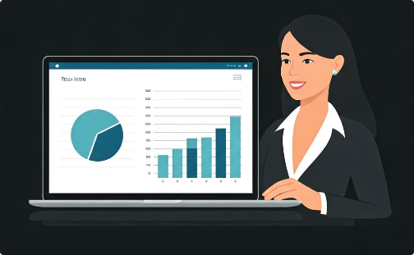
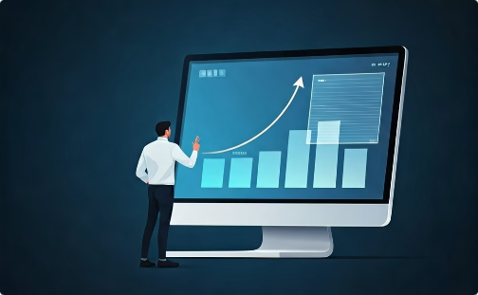
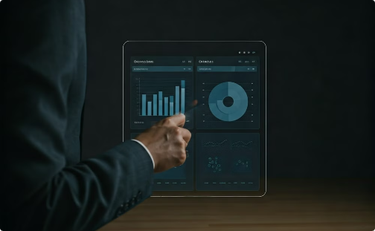
Data Visualization
Interactive Data Exploration
Engaging Visualizations
Understanding Correlations
The dashboard will include various visualizations such as bar charts, line graphs, and heat maps to represent the relationship between mental health and technology usage variables.
To present the findings in an interactive and visually appealing manner, a dashboard will be created using Power BI.
We can interact with the dashboard to explore the data and gain a better understanding of the patterns and correlations.

Slide 14
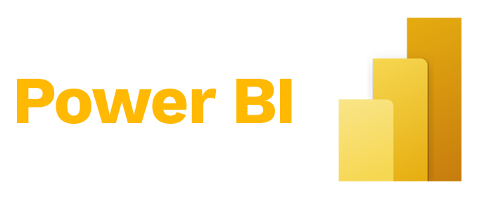

Slide 15


Slide 16
Let’s have a deeper look
& Break things down!

Slide 17
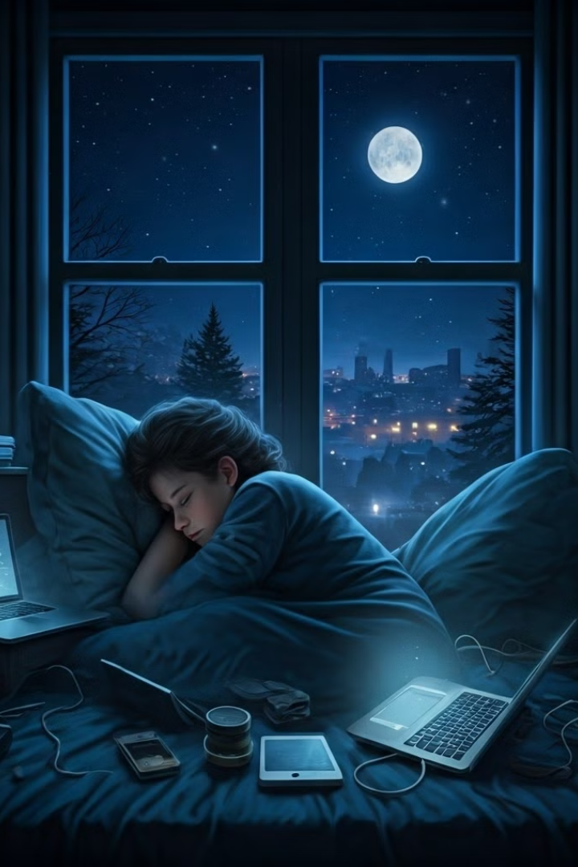
The Sleep Paradox: Night Owls in a Digital Age
In our tech-driven world, sleep has become a commodity. Our study of 15,000 users reveals an intriguing paradox. While most report being well-rested, technology use may tell a different story.
Let's explore how our digital habits impact our sleep and well-being.

Slide 18
Gaming: Fun or Sleep Thief?
Gaming Hours
Stress Levels
Mental Health
Increased gaming time correlates with decreased sleep duration. Late-night sessions disrupt natural sleep cycles.
As gaming hours increase, so do stress levels. This is especially true for those with fair or poor mental health.
A small percentage report excellent mental health. These users likely balance screen time and rest effectively.

Slide 19

Screen Time: The Silent Work Saboteur
1
Neutral Impact
53% of users report no significant effect on job performance from tech use.
2
Negative Impact
37% feel the negative effects of stress and sleep deprivation in their work.
3
Positive Impact
Only 9% report improved work performance, suggesting a need for better tech-life balance.

Slide 20

The Mental Health Puzzle
Normal Screen Time (0-4 hours)
Users with moderate screen time tend to report better mental health outcomes.
High Screen Time (8+ hours)
Excessive screen time correlates with a significant decline in mental health.
Sleep Quality
Poor sleep quality is linked to lower mental health scores across all categories.

Slide 21




Social Media vs. Physical Activity
Social Media Usage
Higher social media use correlates with poorer mental health outcomes.
Physical Activity
Users engaging in 3+ hours of physical activity report better mental health.
Online Support
Surprisingly, online support systems show minimal impact on mental health outcomes.

Slide 22




Stress: The Silent Productivity Killer
Negative Impact
Neutral Effect
Positive Outcomes
20% report stress negatively affects their work performance.
35% claim stress has no significant impact on their work.
44% report positive work outcomes despite stress.

Slide 23

Mental Health and Work Performance
Mental Health
Positive Work Impact
Neutral Work Impact
Negative Work Impact
Excellent
34%
High
Low
Good
Moderate
Moderate
Low
Poor
Low
Low
High

Slide 24
Social Media and Physical Activity at Work
Social Media Impact
Physical Activity Benefits
Balance is Key
Higher social media use (3.5 hours) correlates with negative work outcomes.
Users with 4+ hours of activity report better work performance.
Moderate social media use and regular physical activity contribute to work success.

Slide 25

Sleep and Stress: Work Performance Factors
1
Sleep and Positive Work Impact
6.6K users with better sleep report positive work outcomes.
2
Sleep and Negative Work Impact
4.8K users with less sleep experience negative work impacts.
3
Stress Levels
Higher stress scores (3.0) correlate with negative work performance.
4
Low Stress Benefits
Users with positive work outcomes report lower stress levels (1.0).

Slide 26

Balancing Act: Technology, Sleep, and Work
1
Awareness
Recognize the impact of technology use on sleep and work performance.
2
Balance
Find equilibrium between screen time, physical activity, and rest.
3
Improvement
Implement strategies to enhance sleep quality and reduce stress levels.
4
Success
Achieve better mental health and improved work outcomes through balanced habits.

Slide 27

The Silent Stress Epidemic: Unveiling Digital Age Pressures
15,270
43%
38%
Users in dataset
Experience medium stress levels
Report low stress
20%
42.86%
Facing high stress
Users in low-stress category with strong mental health

Slide 28
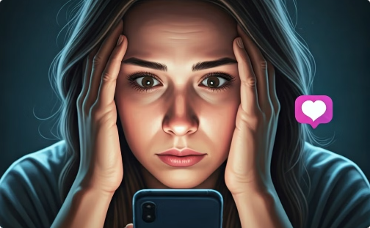


Digital Dilemma: Social Media's Stress Toll
High Stress Users
Low Stress Users
Physical Activity
Spend an average of 3.5 hours on social media daily. This excessive screen time correlates with increased stress levels.
Limit social media use to 1.8 hours per day. This moderation appears to contribute to lower stress levels.
Users engaging in 3+ hours of daily physical activity report lower stress. Exercise acts as a natural stress buffer.

Slide 29
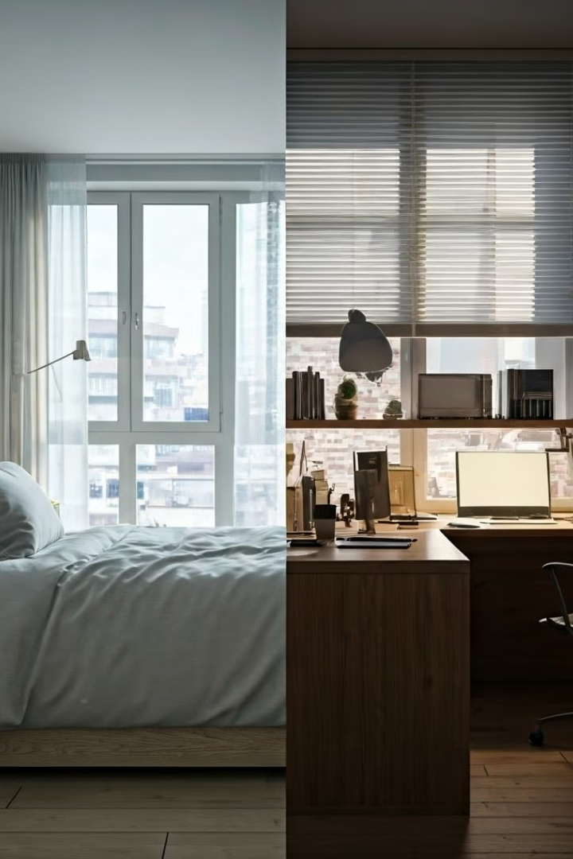



Sleep and Work: The Stress Connection
Sleep Quality
5.4K low-stress users report good sleep. Only 2.5K high-stress users achieve adequate rest. Sleep is crucial for stress management.
Work Environment
High-stress users rate work negatively (3.0 stress score). Low-stress individuals report positive work impacts (1.0 stress score).
Stress Reduction
Improving sleep habits and work environments could significantly lower stress levels. Tech solutions may help track and optimize both.

Slide 30
Conclusion

Slide 31
Conclusion and Recommendations
Healthy Technology Habits
Unhealthy Technology Habits
Set screen time limits.
Excessive scrolling and mindless browsing.
Practice mindful tech use.
Neglecting real-life relationships.
Prioritize real-life interactions.
Experiencing withdrawal symptoms when offline.
Utilize tech for productivity and well-being.
Prioritizing online validation over personal fulfillment.

Slide 32

Finding a Healthy Balance
1
2
Set Boundaries
Mindful Use
Establish clear limits on screen time and technology use. Allocate specific hours for digital activities and dedicate time for offline pursuits.
Practice mindful technology consumption. Engage in activities that promote mental well-being, such as exercise, meditation, or spending time in nature.
3
4
Prioritize Real-Life Connections
Seek Support
Make time for meaningful in-person interactions with family and friends, fostering stronger relationships and reducing feelings of loneliness.
Don't hesitate to seek professional help if you're struggling with technology-related mental health issues. Therapists and support groups can provide guidance and strategies for managing technology use.

Slide 33

Thank you for your time and attention.
We hope this presentation has provided valuable insights and inspiration. We appreciate the opportunity to share our work and looking forward to present this to you.

